Slide 1
So git ?
Using gitlab (for MCM)
4th of October 2017

Slide 2
What is it?
Git is an open source distributed version control system designed for speed and efficiency.
fast (built for linux)
local - able to work offline
harder to ‘lose’ changes

Slide 3
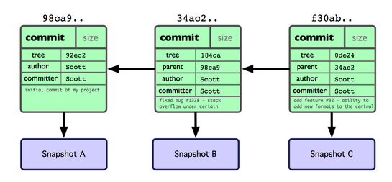
What is git?
Stores ‘snapshots’ of your work
And the relationship between those snapshots

Slide 4
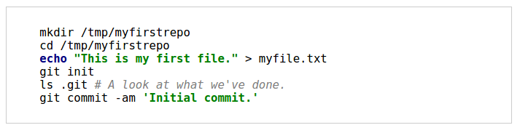
Getting started

Slide 5
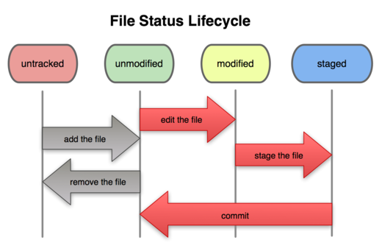
Untracked
Git doesn't know about these files
Tracked, unmodified
Git knows about them, and there have been no changes.
Tracked, modified
File is in git, but changes have been made that git doesn't know about.
Staged
Changes to this file will be committed next time you commit.

Slide 6
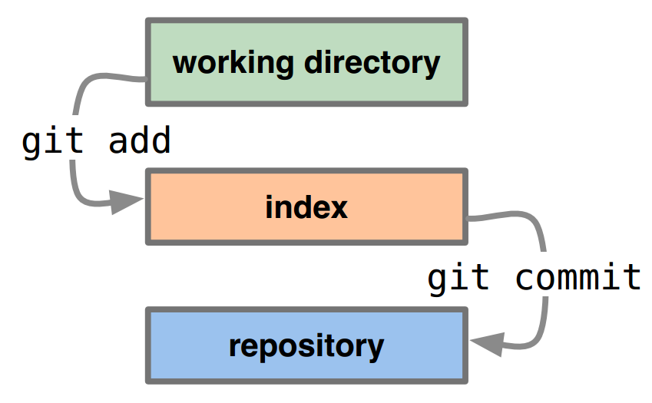
What’s happening?

Slide 7
What’s happening?
local
local
“staging”
local
(push to remote)

Slide 8
A basic workflow
Edit files
Stage the changes
Review your changes
Commit the changes
Upload to remote
vim / emacs / etc
git add (file)
git status
git commit -a
git push

Slide 9
Why?
Record of changes (date, comment, diff)
Ability to ‘roll-back’ to a previous version
Have multiple ‘branches’ of software (public, beta, functionX, etc.)
Collaboration with team members and others (‘merge’)

Slide 10
MCM
https://einstein.computing.dcu.ie/misc/project.html?module=mcm/
Regular assignment submission via push
Updated files from “client” via fetch & merge
Deadline time is hard (must be pushed before 11am)

Slide 11

fork: once only on gitlab web site
clone: one per machine (eg. lab & at home)
add;commit;push: regularly as changes made
remote: once per machine
fetch;merge: at briefing or as instructed
https://einstein.computing.dcu.ie/misc/project.html?module=mcm
fork
https://gitlab.computing.dcu.ie/username/2018-mcm-XXXX
$ git remote add upstream https://...username/2018-mcm-XXXX…
# only do remote add ONCE
$ git fetch upstream
$ git diff upstream/master
$ git merge upstream/master master
$ git clone https://...
$ git push
$ git add;commit

Slide 12
MCM
Fork this “master repository” - amccarren/2018-mcm-XXXX “your repository”
There is one master and one “your repository”
There can be many “local” - in the lab, on your laptop, at home
Don’t forget to pull new content from “your repository” and push changes back to “your repository” from “your locals”

Slide 13
Resources
http://nyuccl.org/pages/GitTutorial/ - basics
http://vimeo.com/14629850 - overview video
http://try.github.io - interactive tutorial
http://git-scm.com/videos - intro videos
http://www.clearvision-cm.com/wp-content/uploads/2014/08/Git-Cheat-Sheet_Clearvision.pdf - cheat sheet (useful overview)

